Slide 1
CS2704:
Final Project
Live Market Prediction Using AI
By: Keegan Hutchinson
GitHub Repo:
https://github.com/keeg-Hson/CS2704-Market-Prediction-Algorithm

Slide 2
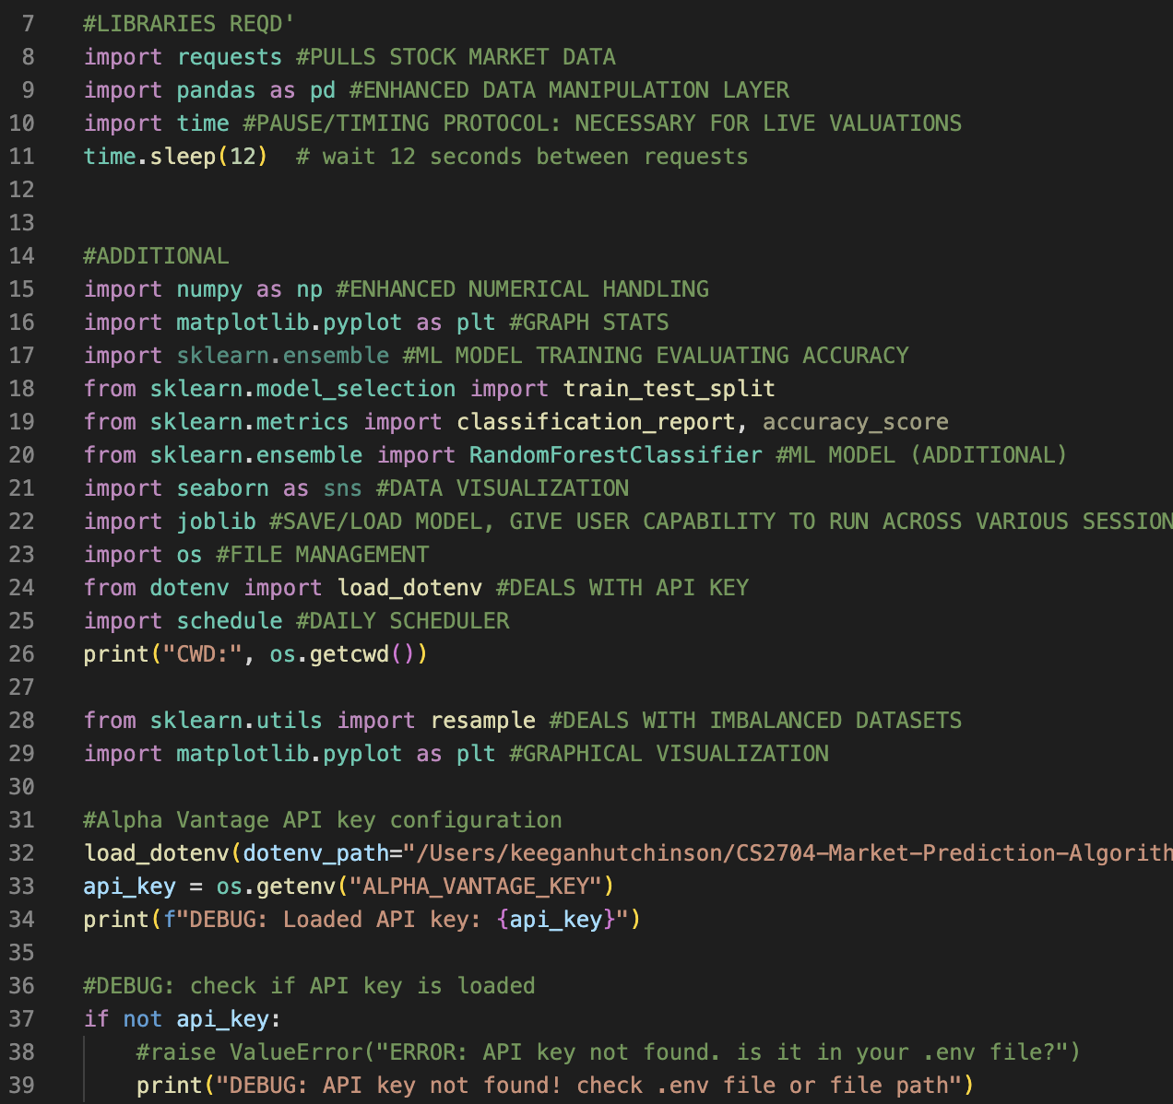
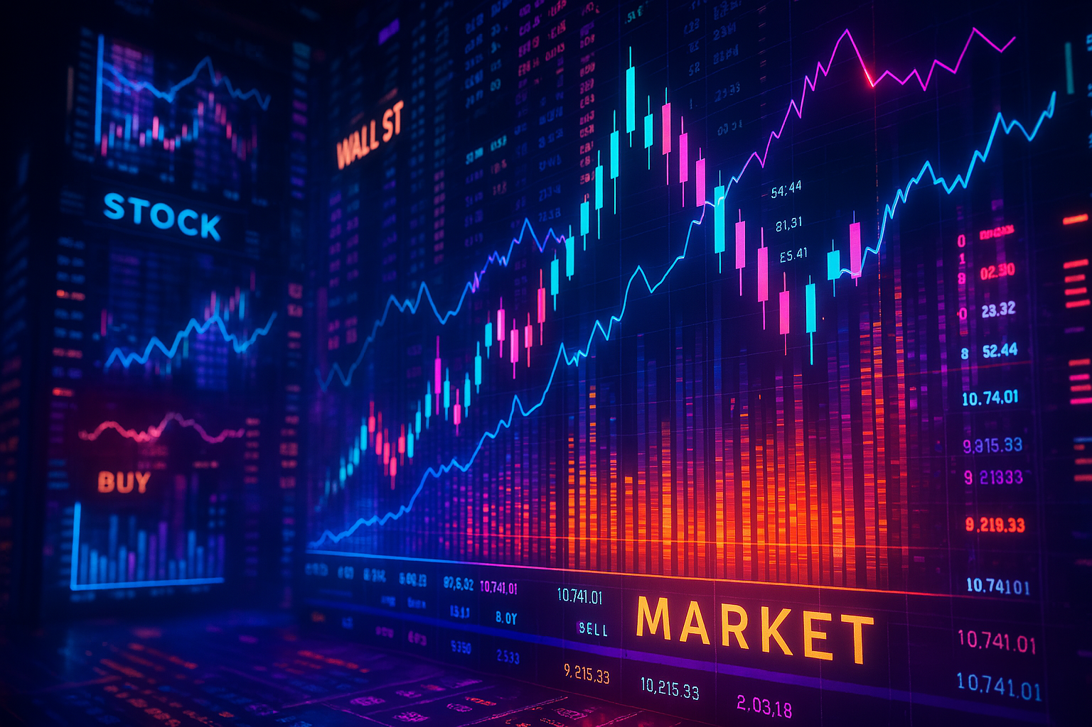
Part 1:
Introduction/Hypothesis

Slide 3

Part 1.1: Introduction
TL;DR:
The following project was both designed and implemented to pose as a machine learning algorithm that seeks to predict both past, present, and future stock market behaviours (such as market spikes and crashes) with the utilization of both built in technical indicators (such as RSI, moving average, and volatility calculations), as well as a Random Forest machine learning classifier model.

Slide 4

Part 1.2: Hypothesis
Hypothesis:
That stock market movements can be both modeled and predicted with the use of technical indicators (KPIs)
KPIs used:
RSI
Volatility
Returns
API used (our dataset) : Alpha Vantage TIME_SERIES_DAILY
ML Model: Random Forest Classifier

Slide 5

Part 2:
Pipeline Breakdown

Slide 6
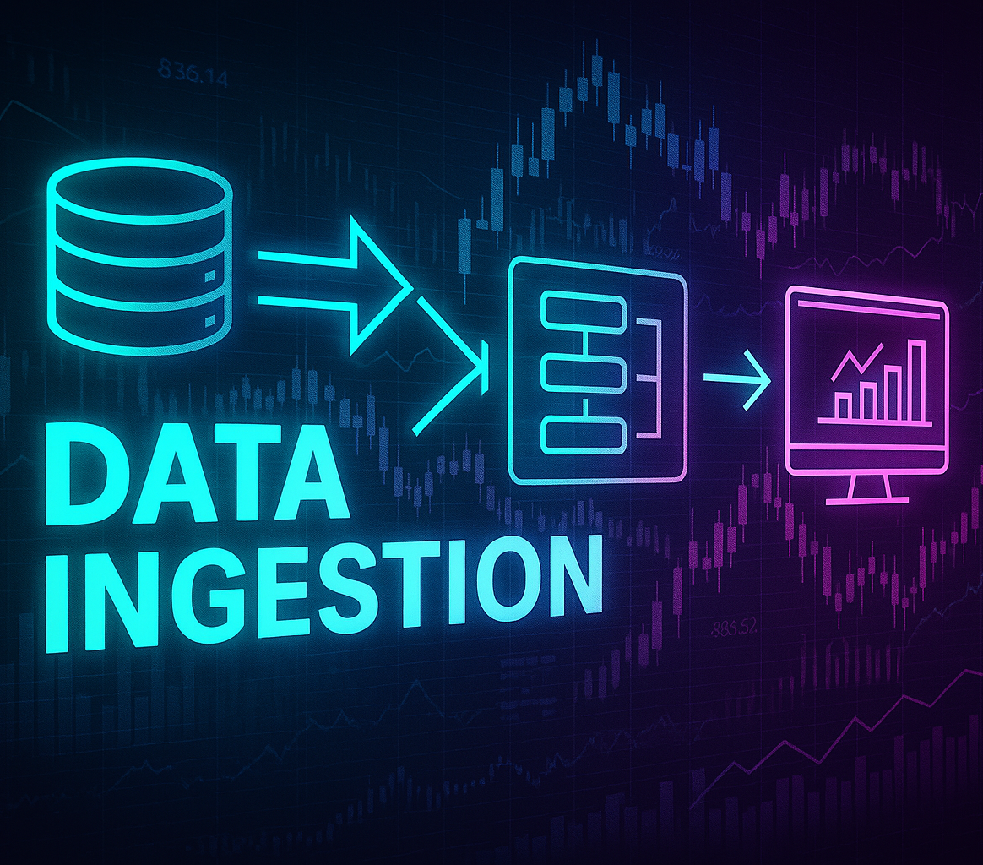

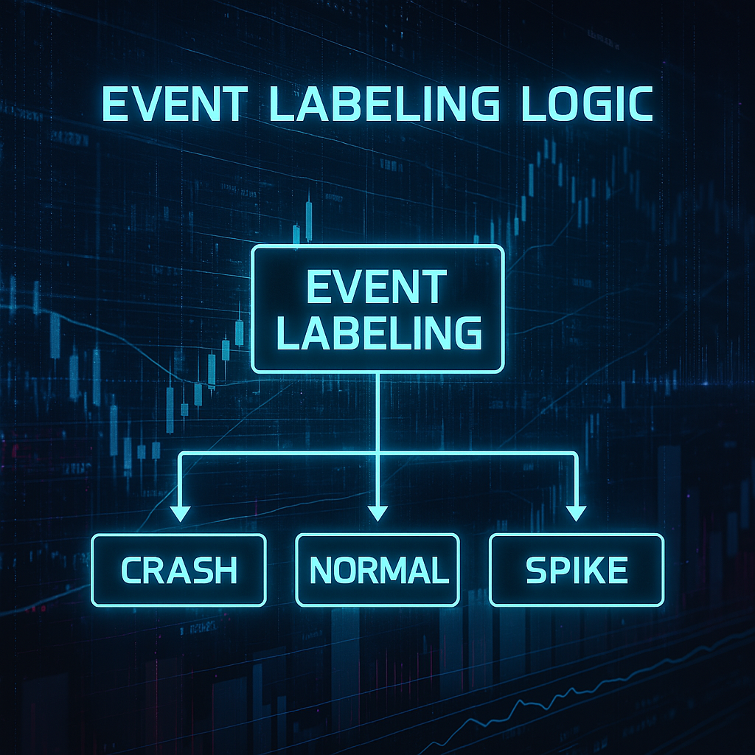


Pipeline Components:
*Actual program consists of ~434 lines of code that didn't fit too nicely into here :(
2.
3.
4.
5.
Data Ingestion:
Deals with extracting live market valuations to be further computed further down pipeline.
Feature Engineering:
Structures set functionality for algorithms technical features
Includes: MA_20, Volatility, Return metrics
Event Labeling Logic:
Implementation of binary classification system that assigns numerical value based off of predicted future return valuations
1==’normal ’, 0==’crash’
Balance Datasheet:
Involves balancing our extracted dataset valuations as appended to our respective .txt file
ML Model Architecture:
Based on Random Forest ML classifier
Involves recursive retraining of our actual ML model with use of our extracted data valuations.

Slide 7
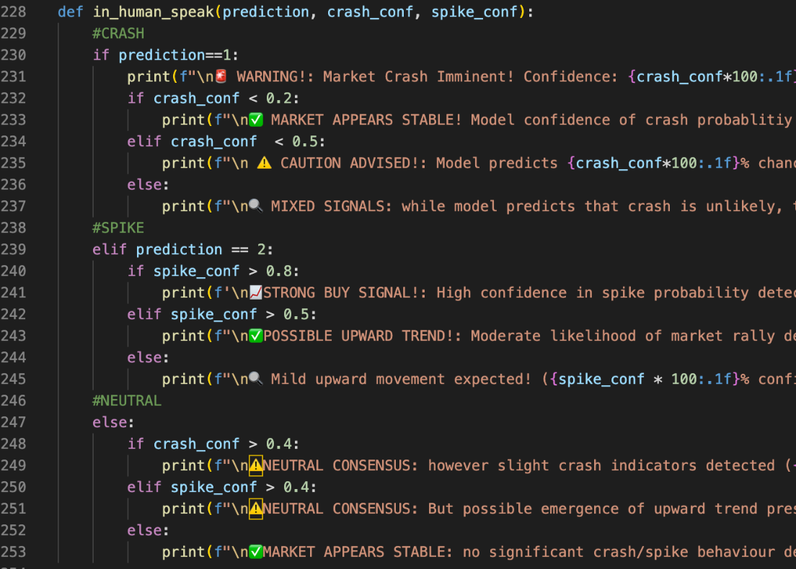
Pipeline Components (Part 2):
Additional: in_human_speak() Function:
Poses as more of an additional UX feature
Takes numerical/statistical data extractions and associated calculations and turns these findings into something readable

Slide 8
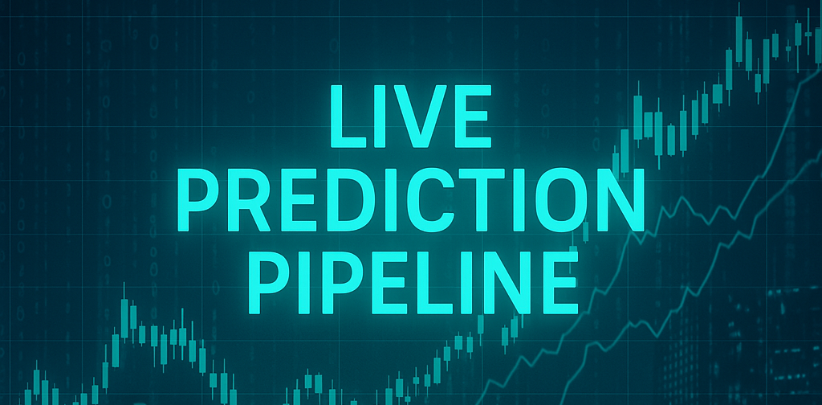
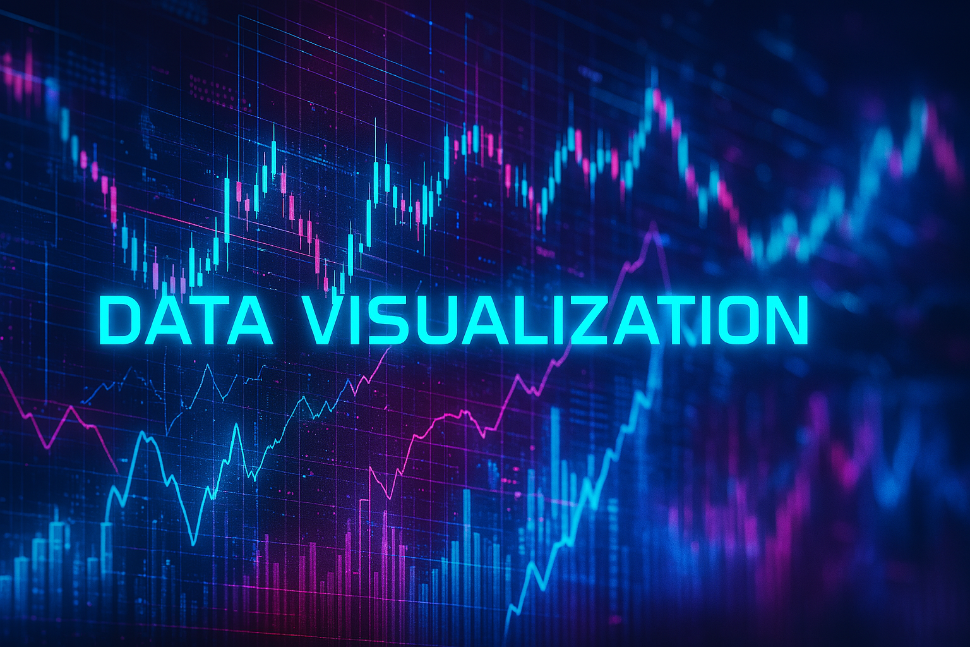

Pipeline Components (Part 3):
6. Live Prediction Pipeline
7. Data Visualization
8. Main Pipeline
Maintenance of a live + consistent prediction log
Purpose: for model retraining + data consistency
Includes accompanying confidence scores extracted from previous processes
Includes a monthly model retraining function
Takes prior renditions + turns figures into readable data
Utilizes pandas library
Line graphs with plotted spike/crash predictions
Includes functionality for user to run program
Involves main functionality of program
Runs above functions in sequence
Effectively, this component is the ‘engine’ that powers our programs overall functionality/associated operations

Slide 9

Pipeline Components (Part 4):
Additional:
Daily Scheduler Function:
Runs program at 6:00PM daily
Includes functionality to run program once, then schedule to run once on a daily basis
Features primary intention is to maintain accurate model retraining data valuations

Slide 10

Part 3:
Results

Slide 11
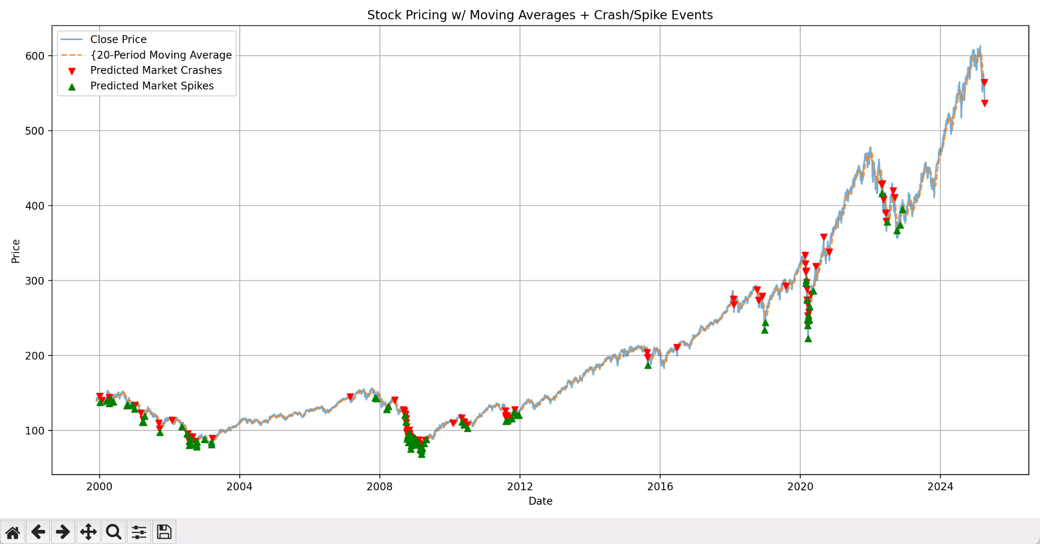
Generated Visualizations:
Results:
Key Findings:
Predicted 2008 and 2020 stock market crashes, as well as subsequent rebounds
In this case, larger arrow clusters=higher probabilities of market volatility
More recently, algorithm is adequately anticipated ongoing 2025 market crash
According to my algorithms continued evaluation, this current crash is expected to continue (not a financial advisor btw)

Slide 12
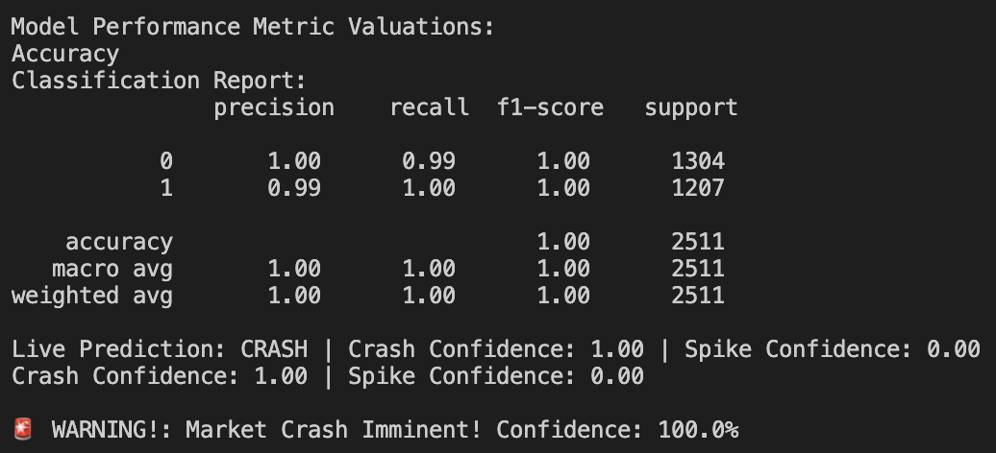
Terminal Output:
Results:
Key Findings:
These are the key metrics as extracted from both our parsed data and subsequent algorithmic synthesis (as of 04/07/2025)
Plotted outputs largely based off of this data + associated calculations.

Slide 13

Part 4:
Use Cases

Slide 14

Software Use Cases:
Would Prove Useful For:
Traders/Analysts
Early crash/spike forecasting to guide early buying decisions
Financial Institutions
AI assisted forecasting, short term market moves
FinTech Apps
Embedding live AI prediction capabilities into investment platforms
Research
KPI correlation exploration + ML model testing

Slide 15

Part 5:
Future Improvements

Slide 16

Future Improvements:
Things to Consider
Model overly reliant on technical indicators
KPI metrics limited, sole prediction metrics used
Could implement broader array of KPI metrics
Could also implement non-numerical metrics
I.e: Macroeconomic conditions, news sentiment/social media parsing function

Slide 17

Future Improvements (Part 2):
Things to Consider
Move away from Random Forest Classifier
Though robust, the static nature of the Random Forest model may not be ideal long term
Incapable of pivoting dynamically to market conditions in real time
Ultimate Vision:
To create a dynamic & multifaceted market trading AI that reads, adapts, and evolves to volatile market conditions like a financial trader from the future.

Slide 18
Thank You!
:)
GitHub Repo:
https://github.com/keeg-Hson/CS2704-Market-Prediction-Algorithm

